Slide 1
Implementation of Long Short‐Term Memory and Gated Recurrent Units on grouped time‐series data to predict stock prices accurately
Oluchi Otuadinma
Data Science Research Topics
Lawi, A., Mesra, H. & Amir, S. Implementation of Long Short-Term Memory and Gated Recurrent Units on grouped time-series data to predict stock prices accurately. J Big Data 9, 89 (2022).

Slide 2
This research paper details the use of deep learning technologies to improve predictive forecasting techniques which have yielded low-accurate results in previous studies. “This paper proposes eight new architectural models for stock price forecasting by identifying joint movement patterns in the stock market”.
The technique combines the Long Short-term Memory (LSTM) and Gated Recurrent Units (GRU) models with four neural network block architectures. A direct model, a downsizing model, a tuned down model, and a stabilised downsizing model.
The architectural models are then evaluated using three accuracy measures obtained from the loss function. Mean Absolute Percentage Error (MAPE), Root Mean Squared Percentage Error (RMSPE) and Rooted Mean Dimensional Percentage Error (RMDPE). They represent lower, true and higher accuracy

Slide 3
Recurrent Neural Networks
A recurrent neural network (RNN) is a type of neural network architecture whose processing is repeatedly called to process the input. RNNs have connections that loop back allowing memory from the previous input to be carried over. This makes it perfect for sequential data especially time-series data.
They contain an input layer for sequence data, a hidden layer with recurrent connections to capture temporal dependencies. Finally, an output layer often performed with a SoftMax function for categorical output, to make predictions or classifications.
ℎ _{𝑡}​ ​ = 𝜎(𝑊_{h} ​ ℎ _{𝑡 -1}​ ​+ 𝑊_{x} 𝑥_{𝑡} + b_{h}​ )
Where:
ℎ _{𝑡}​ = hidden state
ℎ _{𝑡 -1}​ = previous hidden state
𝑥_{𝑡} = the current input
𝜎 = activation function (like tanh or ReLU)

Slide 4
Challenges of RNN’s
There are challenges involved such as a vanishing or exploding gradient. This occurs in long chains of dependencies as the repeated multiplications through the steps change the sizes of the weights.
Vanishing Gradients
Early RNNs suffered from gradients becoming very small, inadvertently causing the weights in earlier layers, or time steps, to update very slowly, hindering learning. This hinders the model’s ability to capture long-term dependencies
Exploding Gradients
Although the inverse may happen, the gradients become so excessively large the weights updates are unstable throughout the layers. The loss function may diverge leading to training failure.

Slide 5
Long Short-Term Memory (LSTM)
The Long Short-term Memory was proposed with the motivation of addressing the gradient vanishing/explosion problem it introduces memory cell states and gates to control the error flows. They enable neural networks to learn long-term dependencies between time series and sequence data
The operation of an LSTM unit consists of :
i_{𝑡} = 𝜎(𝑊_{f} · [ℎ _{𝑡 -1}​ ​, 𝑥_{𝑡} + b_{i} ),
f_{𝑡} ​ = 𝜎(𝑊_{f} · [ℎ _{𝑡 -1}​ ​, 𝑥_{𝑡} + b_{f} ),
o_{𝑡} = 𝜎(𝑊_{f} · [ℎ _{𝑡 -1}​ ​, 𝑥_{𝑡} + b_{o} ),
ĉ_{𝑡} = tanh(𝑊_{c} · [ℎ _{𝑡 -1}​ , 𝑥_{𝑡} ] + b_{c})
C_{𝑡} = f _{t} ⊙ c _{t -1} + i _{t} ⊙ ĉ _{t}
ℎ_{𝑡} = o _{t} ⊙ tanh(c _{t})
Where :
i_{𝑡} : input gate
f_{𝑡} ​ : forget gate
o_{𝑡} : output gate
𝑥_{𝑡} : input
C_{𝑡} :memory cell state
ℎ_{𝑡} :hidden state
⊙ : pointwise multiplication

Slide 6
Gated Recurrent Units (GRU)
Gated Recurrent Units were created as a simpler version of LSTM’s that would require less computational power. LSTMS three gates are replaced with two; the reset gate and the update gate. Still given sigmoid activations, the reset gate determines how much of the previous state(h _{t -1}) should be reset or forgotten and the update gate controls how much of the new state is a copy of the old one.
𝑟_{𝑡} ​= 𝜎(𝑊𝑟 ​⋅[ℎ _{𝑡 -1} ​, 𝑥_{𝑡} ])
Where:
𝑟_{𝑡} = reset gate at time step.
𝜎 = sigmoid activation function.
𝑊𝑟 = weight matrix for the reset gate.
ℎ _{𝑡 -1}​ = hidden state at the previous time step.
𝑥_{𝑡} =​ input at time step 𝑡t.
𝑧_{𝑡} ​= 𝜎(𝑊_{𝑧} ​⋅[ℎ _{𝑡 -1} ​, 𝑥_{𝑡} ])
Where:
𝑧_{𝑡} = update gate at time step 𝑡.
𝑊_{𝑧} = weight matrix for the update gate.
The other terms are as described before.

Slide 7
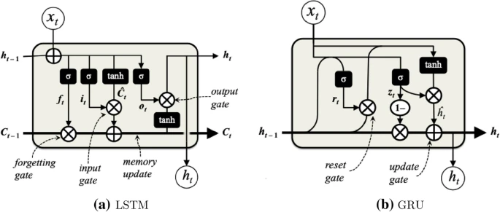
Applications of LSTMs and GRU
LSTM’s work well as part of natural language processing (NLP) to perform sentiment analysis or machine translation. They are effective with time series analysis such as stock price prediction and weather forecasting.
The major difference between the two is their capacities for prediction. LSTM’s work better with long-term memory tasks, machine learning or speech recognition, but GRU’s are simpler, less complex, and can handle simpler tasks quickly with less computational requirements.
Fig 1: Structure of the LSTM and GRU blocks and their gates:

Slide 8
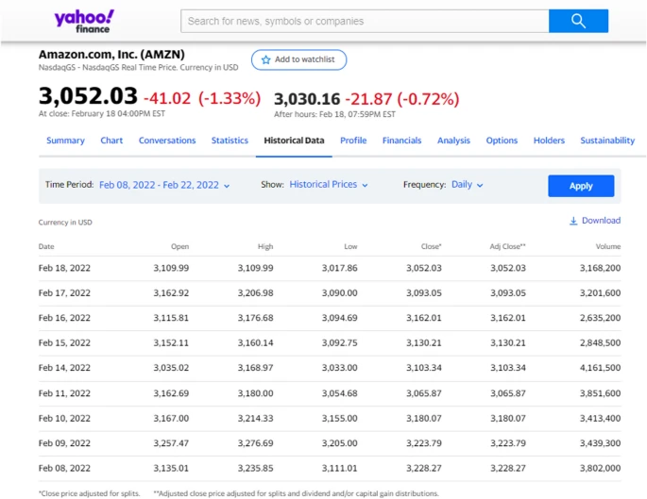
Data collection
The models used in this paper were conducted on historical data from company stock market prices obtained from the Yahoo Finance website.
The investigations were made on a collection of time series stock data of four companies coded AMZN, GOOGL, BLL and QCOM for 12 years between January 4, 2010, and February 3, 2022.
Each company has 15,220 datasets consisting of four price data and one volume data that make up 60,880 data
As the close open and high prices on any specified day are relatively similar, the close prices have been used
Fig 2: An example of AMZN stock price time series data for two weeks

Slide 9
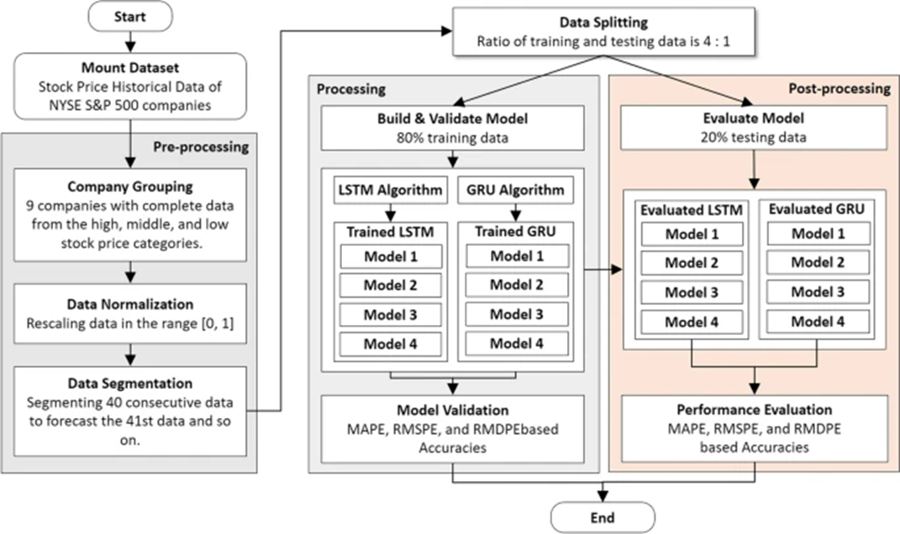
Methods
The investigation consisted of three stages, the pre-processing/data preparation, data processing/model building, and the post-processing/performance evaluation.
The steps are to first predict each company’s stock by running the LSTM/GRU separately on different companies. To then combine what was learned into a flattened array to be used in the concatenation model. This analyses the grouped patterns to make predictions on stock market movements. The end goal is to observe if combining individual learning with group learning improve the models prediction accuracy
Fig 3: Proposed LSTM and GRU forecasting method

Slide 10
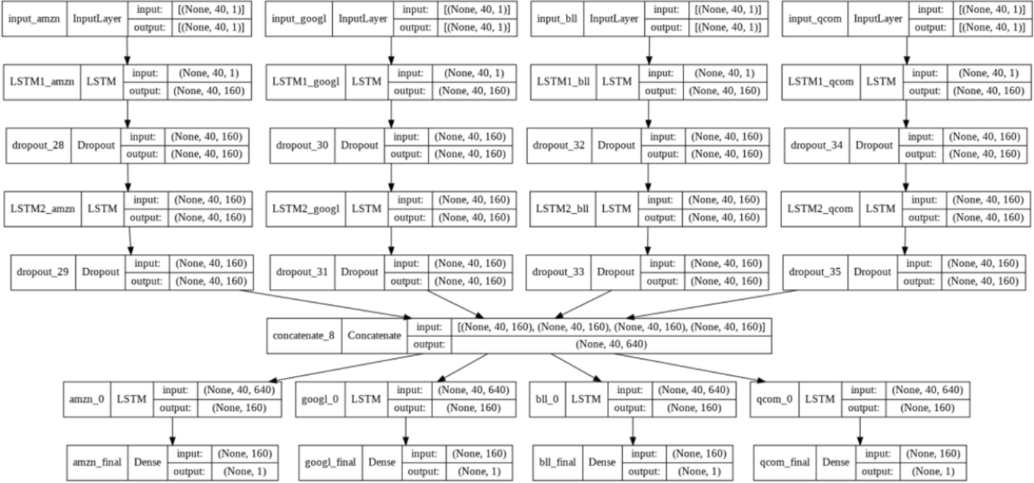
In between the concatenation step and the individual stock price forecasting step, there are the four LSTM/GRU model architectures.
Model 1 : the direct model
The model directly distributes the output shape. (None, 40, 640) to the four LSTM/GRU models

Slide 11
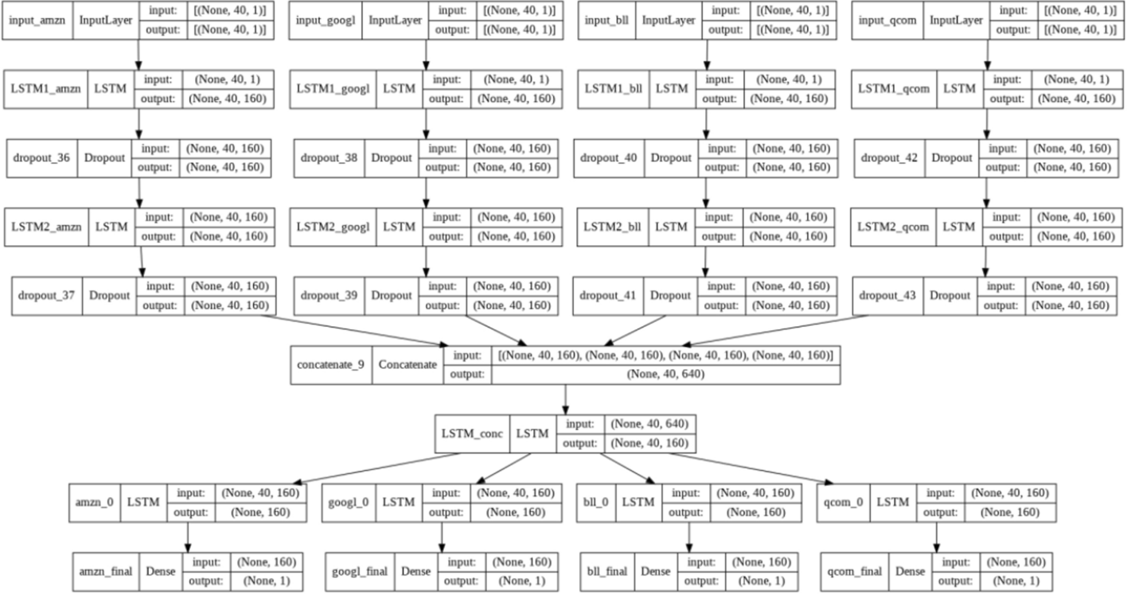
Model 2: downsizing model
The output shape of (None, 40, 640) to become 160 values and after that, it distributes the downsized shape to the four LSTM/GRU models

Slide 12
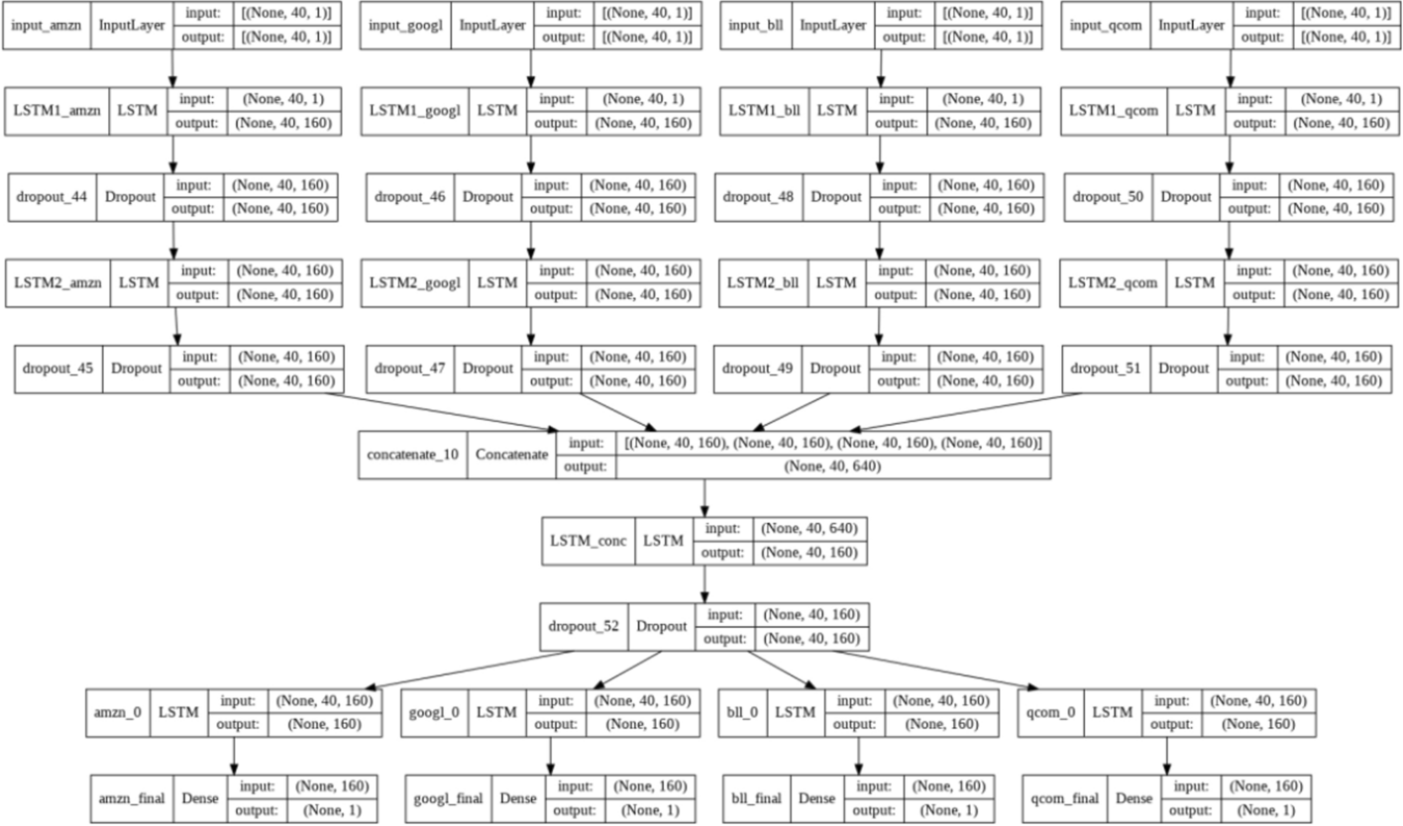
Model-3: tuned downsizing model
The output shape of (None, 40, 640) to become 160 values, and then it tunes the parameters by applying dropout.

Slide 13
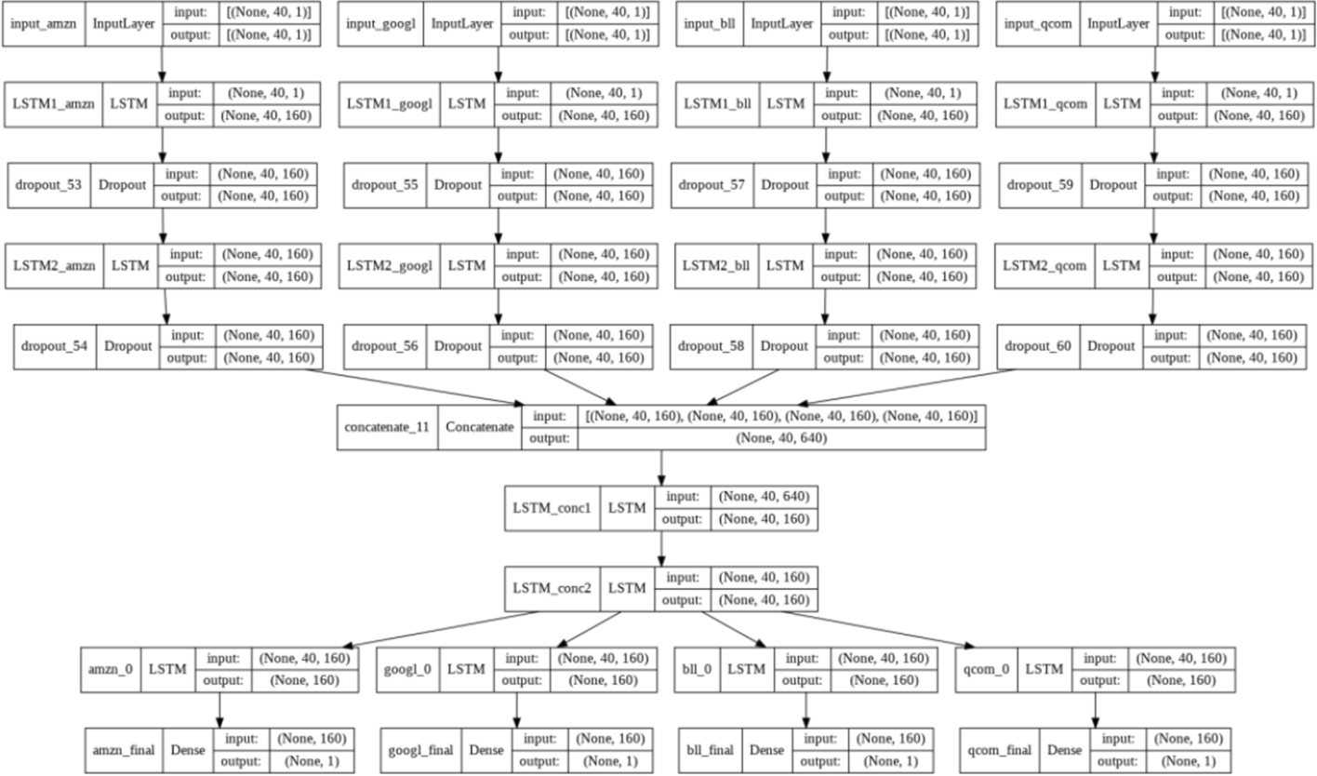
Model-4: stabilized downsizing model
The model downsizes the output shape of (None, 40, 640) to become 160 values and then stabilizes its values by applying another LSTM/GRU.

Slide 14
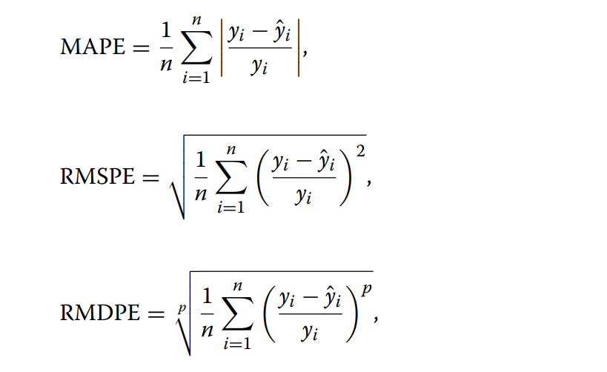
Performance assessment
The function used to evaluate the performance model is the loss error function or the difference between the actual and predictive of the response/label values.
The loss function in this paper uses Mean Absolute Percentage Error (MAPE), Rooted Mean Square Percentage Error (RMSPE), and Rooted Mean Dimensional Percentage Error (RMDPE)
where n, yi and yˆi are the number of data, the actual and prediction of the i^{th} data,
respectively.
MAPE represents the upper limit of the accuracy model, RMDPE represents the lower limit of the accuracy model that can be meant as the lowest risk percentage that can be achieved using the forecasting model and RMDPE is generated from the normalized Minkowski distance, resulting in the furthest distance from the actual value

Slide 15
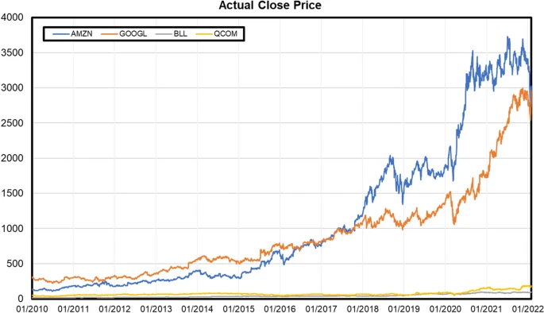
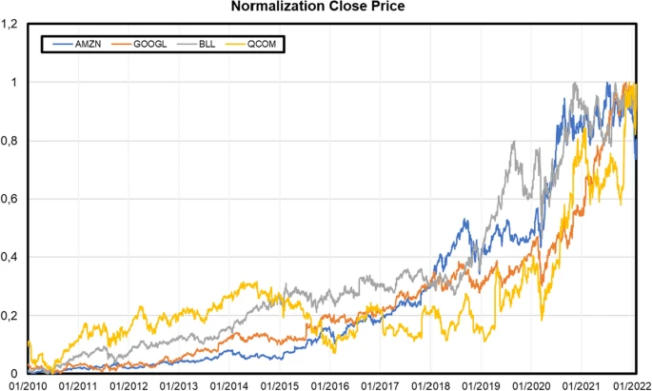
Results
There were four companies considered as they were believed to represent the same technical price behaviour, in the higher stock group are AMZN and GOOGL and in the lower were BLL and QCOM. The data was normalised using the min-max normalisation method to avoid the influence of the dominant pattern of stock price behaviour that significantly affects smaller stocks.
The min-max method was used to guarantee that all the stock price values would operate on the same scale, a value range from 0 to 1.

Slide 16
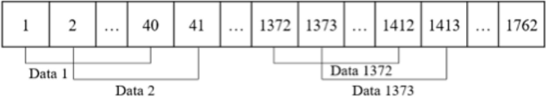
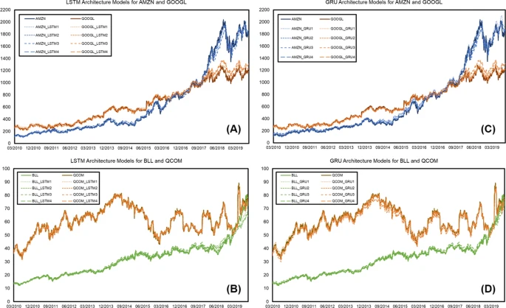
The data is then segmented. Segmentation is the process of separating and grouping data with a predicted value in this case the 41st as the forecast. The data is grouped into many timestep data with sizes of 40 historically ordered data.
Illustration of the data segment
Trained LSTM and GRU architectural models of four companies
The data was then divided into training and testing data 80% to 20% respectively. The training data consists of the first 9 years and 9 months of each of the company’s time-series stock price data, and the testing data is the last 2.5 years

Slide 17
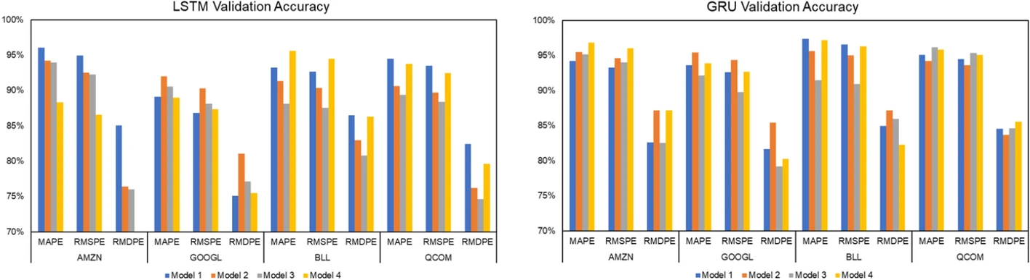
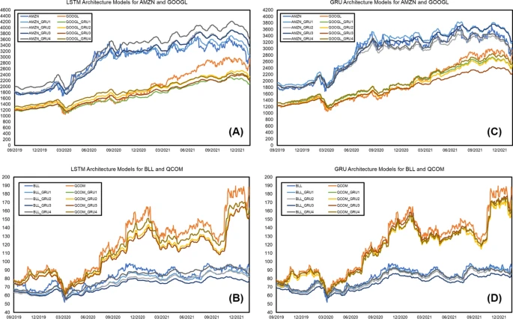
The figures show the accuracy/validation measurements evaluation of the respective model to training data using the percentage error results of MAPE, RMSPE, and RMSDE
Visualization graph of LSTM and GRU Trained Accuracy
The values from the LSTM models don’t show much variance from each other. However, the GRU trained models have better performance in comparison to the LSTM models.
Validation LSTM and GRU architectural models of four companies

Slide 18
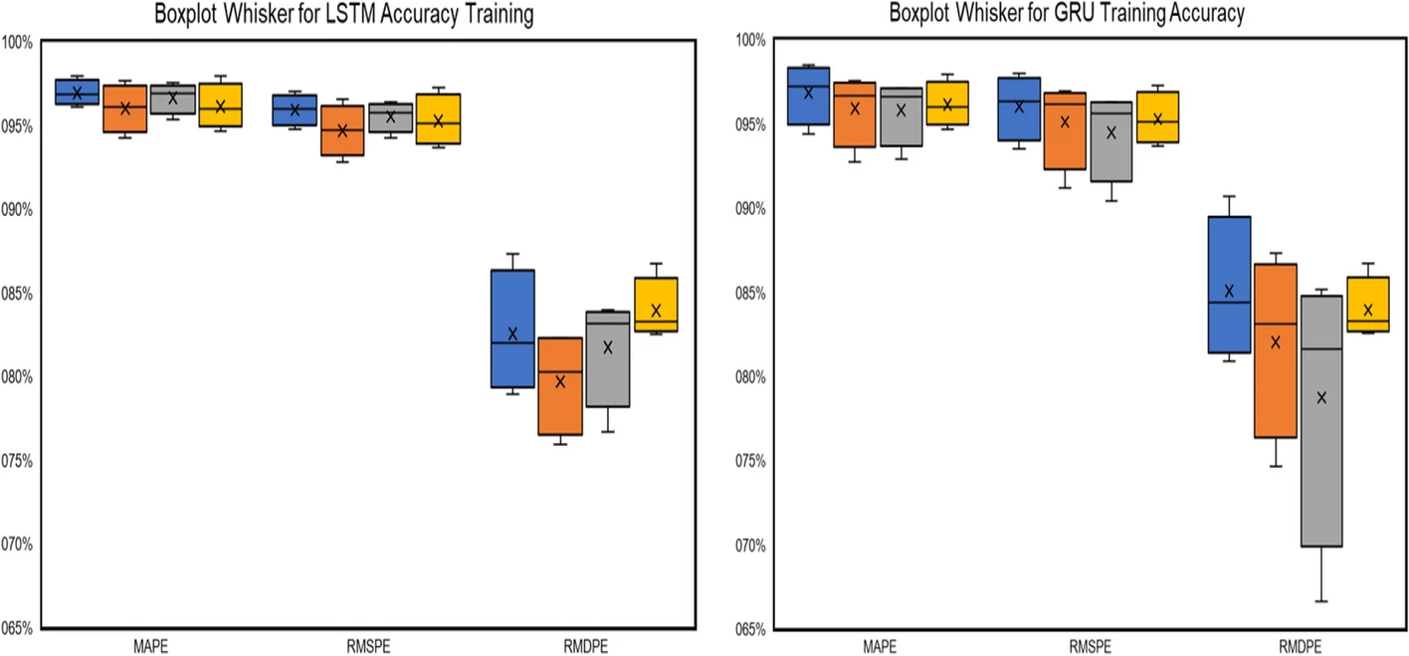
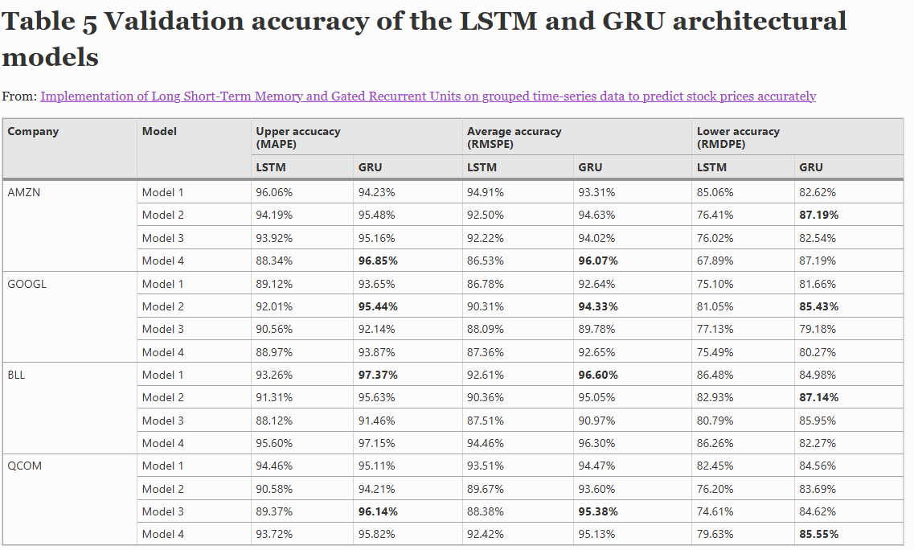
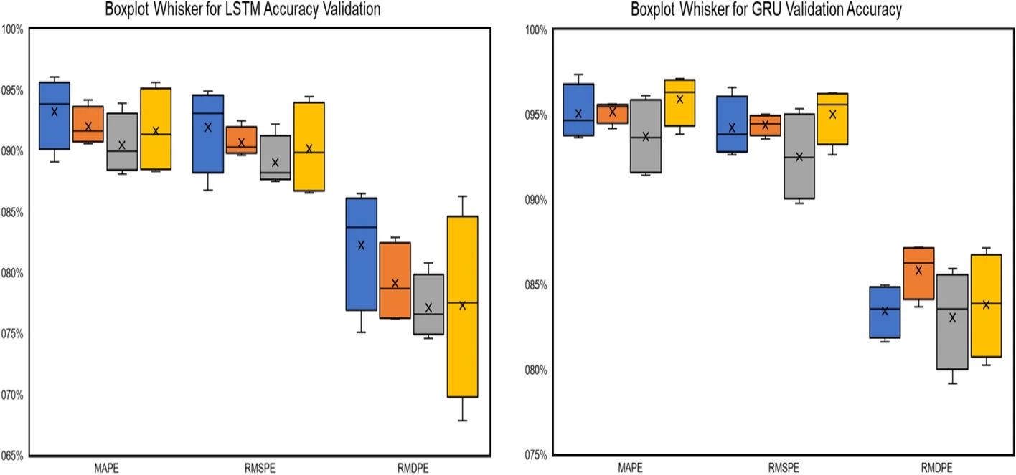
Boxplot Whisker for LSTM and GRU trained model
These are Boxplot-Whiskers for the accuracy distribution pattern of MAPE, RMSPE, and RMDPE for each LSTM and GRU training and validation models architecture for all companies.
Boxplot Whisker for LSTM and GRU validation mode

Slide 19
Conclusion
The technique of combining LSTM and GRU models with four neural network block architectures works successfully
The experimental results for training data, GRU Model-1 provides the highest accuracy for the three metrics, i.e., 98.48% (MAPE), 97.98% (RMSPE), and 90.73% (RMDPE).
Whereas the validation results of the testing data, GRU Model-1 has the highest accuracy 97.37% (MAPE) and 96.60% (RMSPE), and GRU Model-2 yielded 87.19%
However, the boxplot whisker results indicate that the LSTM models have a higher consistency regarding accuracy, making them more consistent or convergent to their accuracy values.

Slide 20
Reference list
Chen W, Zhang H, Mehlawat MK, Jia L. Mean-variance portfolio optimization using machine learning-based stock price prediction. Appl Soft Comput. 2021;100:106943.
Troiano L, Villa EM, Loia V. Replicating a trading strategy by means of LSTM for fnancial industry applications. IEEE Trans Ind Inf. 2018;14(7):3226–34.
Suyanto S, Saftri J, Adji AP. Fundamental and technical factors on stock prices in pharmaceutical and cosmetic companies. Financ Account Bus Anal (FABA). 2021;3(1):67–73.
Srivastava PR, Zhang ZJ, Eachempati P. Deep neural network and time series approach for fnance systems: predicting the movement of the Indian stock market. J Organ End User Comput (JOEUC). 2021;33(5):204–26.
Nabipour M, et al. Predicting stock market trends using machine learning and deep learning algorithms via continuous and binary data; a comparative analysis. IEEE Access. 2020;8:150199–212.
Budiharto W. Data science approach to stock prices forecasting in Indonesia during Covid-19 using Long Short-Term Memory (LSTM). J Big Data. 2021;8(1):1–9.
Zhang Y, Chu G, Shen D. The role of investor attention in predicting stock prices: the long short-term memory networks perspective. Financ Res Lett. 2021;38:101484.
Yan X, et al. Exploring machine learning in stock prediction using LSTM, binary tree, and linear regression algorithms. Int Core J Eng. 2021;7(3):373–7.
Hansson M. On stock return prediction with LSTM networks. Master Thesis, Lund University 2017.
Xiao J, Zhu X, Huang C, Yang X, Wen F, Zhong M. A new approach for stock price analysis and prediction based on SSA and SVM. Int J Inf Technol Decis Mak. 2020;18(1):287–310. https://doi.org/10.1142/S021962201841002X.
Khattak AM, Ullah H, Khalid HA, Habib A, Asghar MZ, Kundi FM. Stock market trend prediction using supervised learning. In: Paper presented at the proceedings of the tenth international symposium on information and communication technology 2019. 2019. p. 85-91. https://doi.org/10.1145/3368926.3369680
Sun J, Xiao K, Liu C, Zhou W, Xiong H. Exploiting intra-day patterns for market shock prediction: a machine learning approach. Expert Syst Appl. 2019;127:272–81. https://doi.org/10.1016/j.eswa.2019.03.006.
Subasi A, Amir F, Bagedo K, Shams A, Sarirete A. In: Paper presented at the 18th international learning & technology conference vol 194. 2021. p. 173-179. https://doi.org/10.1016/j.procs.2021.10.071
Chhajer P, Shah M, Kshirsagar A. The applications of artifcial neural networks, support vector machines, and longshort term memory for stock market prediction. Decis Anal J. 2021;2:100015. https://doi.org/10.1016/j.dajour.2021. 100015.
Qian F, Chen X. Stock prediction based on lstm under diferent stability. In: Paper presented at the 2019 IEEE 4th international conference on cloud computing and big data analysis (ICCCBDA). 2019. p. 483–486. https://doi.org/10.1109/ICCCBDA.2019.8725709
Yadav A, Jha CK, Sharan A. Optimizing LSTM for time series prediction in Indian stock market. In: Paper presented at the international conference on computational intelligence and data science (ICCIDS), vol 167. 2020. p. 2091-2100. https://doi.org/10.1016/j.procs.2020.03.257

Slide 21
Hajiabotorabi Z, Kazemi A, Samavati FF, Maalek Ghaini FM. Improving DWT-RNN model via B-spline wavelet multiresolution to forecast a high-frequency time series. Expert Syst Appl. 2019;138:112842. https://doi.org/10.1016/j.eswa.2019.112842.
Jin Z, Yang Y, Liu Y. Stock closing price prediction based on sentiment analysis and LSTM. Neural Comput Appl. 2019. https://doi.org/10.1007/s00521-019-04504-2.
Liu Q, Tao Z, Tse Y, Wang C. Stock market prediction with deep learning: the case of China. Financ Res Lett. 2021. https://doi.org/10.1016/j.frl.2021.102209.
Nguyen T-T, Yoon S. A novel approach to short-term stock price movement prediction using transfer learning. Appl Sci. 2019;9(22):4745. https://doi.org/10.3390/app9224745.
He Q-Q, Pang P-C-I, Si Y-W. Transfer learning for fnancial time series forecasting. In: Paper presented at the Pacifc rim international conference on artifcial intelligence, vol 2019. 2019. p. 24–36. https://doi.org/10.1007/978-3-030-29911-8_3
Gu Q, Dai Q. A novel active multi-source transfer learning algorithm for time series forecasting. Appl Intell. 2020. https://doi.org/10.1007/s10489-020-01871-5.
Le XH, et al. Application of long short-term memory (LSTM) neural network for food forecasting. Water. 2019;11(7):1387.
Baytas IM, et al. Patient subtyping via time-aware LSTM networks.’In: proceedings of the 23rd ACM SIGKDD international conference on knowledge discovery and data mining 2017.
Goodfellow I, Bengio Y, Courville A. Deep learning. Boston: MIT Press; 2016.
Ingle V, Deshmukh S. Ensemble deep learning framework for stock market data prediction (EDLF-DP). In: Paper presented at the Global Transitions Proceedings vol 2.1. 2021; p. 47–66. https://doi.org/10.1016/j.gltp.2021.01.008.
Moghar A, Hamiche M. Stock market prediction using LSTM recurrent neural network. In: Paper presented at international workshop on statistical methods and artifcial intelligence, vol 170. 2020. p. 1168–1173. https://doi.org/10.1016/j.procs.2020.03.049
Chung J, et al. Empirical evaluation of gated recurrent neural networks on sequence modeling. 2014. arXiv preprint arXiv:1412.3555
Kumar S, et al. A survey on artifcial neural network based stock price prediction using various methods. In: 2021 5th international conference on intelligent computing and control systems (ICICCS). IEEE; 2021.
Hu Z, Zhao Y, Khushi M. A survey of forex and stock price prediction using deep learning. Appl Syst Innov. 2021;4(1):9.
Kurani A, et al. A comprehensive comparative study of artifcial neural network (ANN) and support vector machines (SVM) on stock forecasting. Ann Data Sci 2021 : 1-26.

